Slide 1
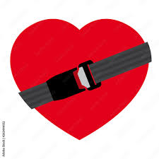
Protecting Your Heart…
From Hackers
A presentation by
Rylan Carney

Slide 2
First Off, an Introductory
Hi. My name is Rylan Carney, and I have a bad heart.
Well, not bad in a fatal sense, but enough that I bet I’ll have to think about a pacemaker in my future. That is fine though, the world of technology and medical advances everyday! Hopefully by the time that I am needing to seriously consider one, there could be more benefits to having a pacemaker than to not have one.
Here is a funny bit of knowledge for you!
Did you know…

Slide 3
Pacemakers Can Be Hacked?
Pretty neat, right? Well, not really
Not just pacemakers, but any medical system can be hacked.
There have been vulnerabilities seen across multiple systems, including insulin pumps, pain pumps, infusion pumps, patient monitors, and many more.
As the medical world evolves and pushes towards systems that primarily connect and utilize the Internet, more and more of these devices can be tampered with.

Slide 4
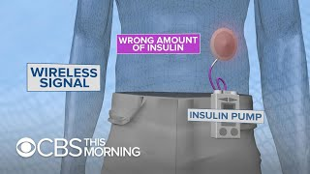
CBS: A Brief Look into Pacemaker Cybersecurity
https://youtu.be/smhPhmNsvVc

Slide 5
A Scary Thought For Our Medical Future
If you watched the previous video, then thank you. If you did not then no worries, I will catch you up to speed.
It was found in 2018 that a good majority of medical devices were capable of being hacked, and vulnerable enough that the question wasn’t what they could hack, but what they couldn’t.
At the time, the idea of hacking a medical machine was a near impossible chance, as the hacker would have to be extremely close in proximity to the patient. However, with the push to make more and more medical care online and from your home, hacking becomes a bigger issue.

Slide 6
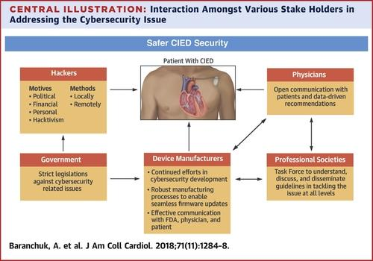
Why Hack A Pacemaker?
For any reason. Why would someone want to hack into anything of yours? Well:
Monetary gain
Personal grudge
A show of power
A scare tactic
Honestly any reason can be used if it drives someone enough to do it. It’s not their life that they are tampering with.
It’s yours

Slide 7
The Problem at Hand
While software and hardware is getting better, companies are lacking in their approaches to cybersecurity on their devices. With an increase in hacking attacks to medical and government systems, it's only so long until people’s actual lives could be at risk. People who’s only real reason for being targeted was because they possessed a health issue that they never wanted.
“Based on research into failure modes, this is not a problem restricted to Abbott. The risks exist for any device that is connected to the Internet. Outside of the realm of CIED management, these issues obviously also apply to other medical devices (pain pumps, insulin pumps, continuous positive airway pressure, and rhythm and hemodynamic monitoring) that are connected to the Internet for remote monitoring and programming purposes.
- Baranchuk, A., Lakkireddy, D. R., Fisher, J. D., Upadhyay, G., Kutyifa, V., Krishnan, K., Chung, M. K., Patton, K. K., & Refaat, M. M. (n.d.). JACC journals. Journal of the American College of Cardiology.

Slide 8




How Would a Hacker Affect A Pacemaker?
Typically for pacemakers, there are two threats identified.
A Battery Drain Attack
and
A Shock Administration

Slide 9
A battery drain attack is when a hacker sends a multitude of requests to your pacemaker, causing the internal battery to drain and, eventually, deplete completely.
A shock administration attack is the hacker causing your pacemaker to send inappropriate jolts to your heart, possibly upsetting your heart’s rhythm.

Slide 10
An Upgrade Given…..and Refused
When these vulnerabilities were discovered, many companies had pushed software updates to fix the issue in their devices. Patients were made aware of the risk and were asked if they could administer the update. Of physicians and patients that were asked, 75% refused
“An analysis by Saxon and her colleagues recently published in Circulation found that most physicians and patients (75%) chose not to have the firmware updated after the pacemaker recall.” - Pacemaker recall highlights security concerns for implantable devices | circulation.
Saxon stated that the patients, no matter their educational level, were capable of understanding

Slide 11
So, What Should We Do?
Pacemakers made after 2018 had the firmware update automatically installed so, for those exact vulnerabilities, they hopefully aren’t as much of a concern.
However, shouldn’t there be an easier a way that patients can talk with and notify their doctors or even their pacemaker manufacturers of risks or concerns than being notified once a massive firmware update is needed?
Thank you for that loaded question, for right here is:

Slide 12
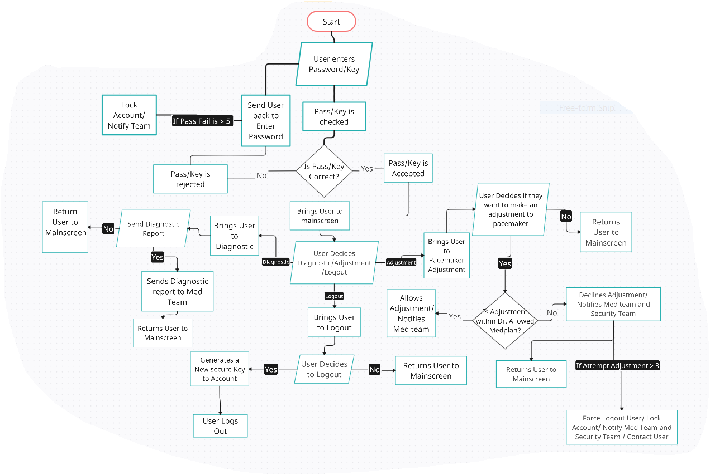
My Pseudo Solution

Slide 13
Simple, But a Start
Essentially, it is just a secure login format that notifies the clinical, and security team if needed, on medical changes and requests given by the patient.
If the patient fails a typical login attempt multiple times, it will notify the security team
Any requests to change any pacemaker activity will be notified and rejected if change goes outside of Dr.’s medplan
Fewer request capabilities hopefully limits battery usage of pacemaker

Slide 14
Medtronic’s MyCareLink
While my idea is simple and there is definite room for improvement, I mainly wanted to tackle certain issues with current pacemaker apps.
MyCareLink is the Medtronic pacemaker app that allows patients to check and send diagnostics to medical teams, record bmi and symptoms, and call clinics nearby to them among other capabilities.
There is no way to contact Dr. directly aside from local clinic number, and no direct help for security concerns

Slide 15
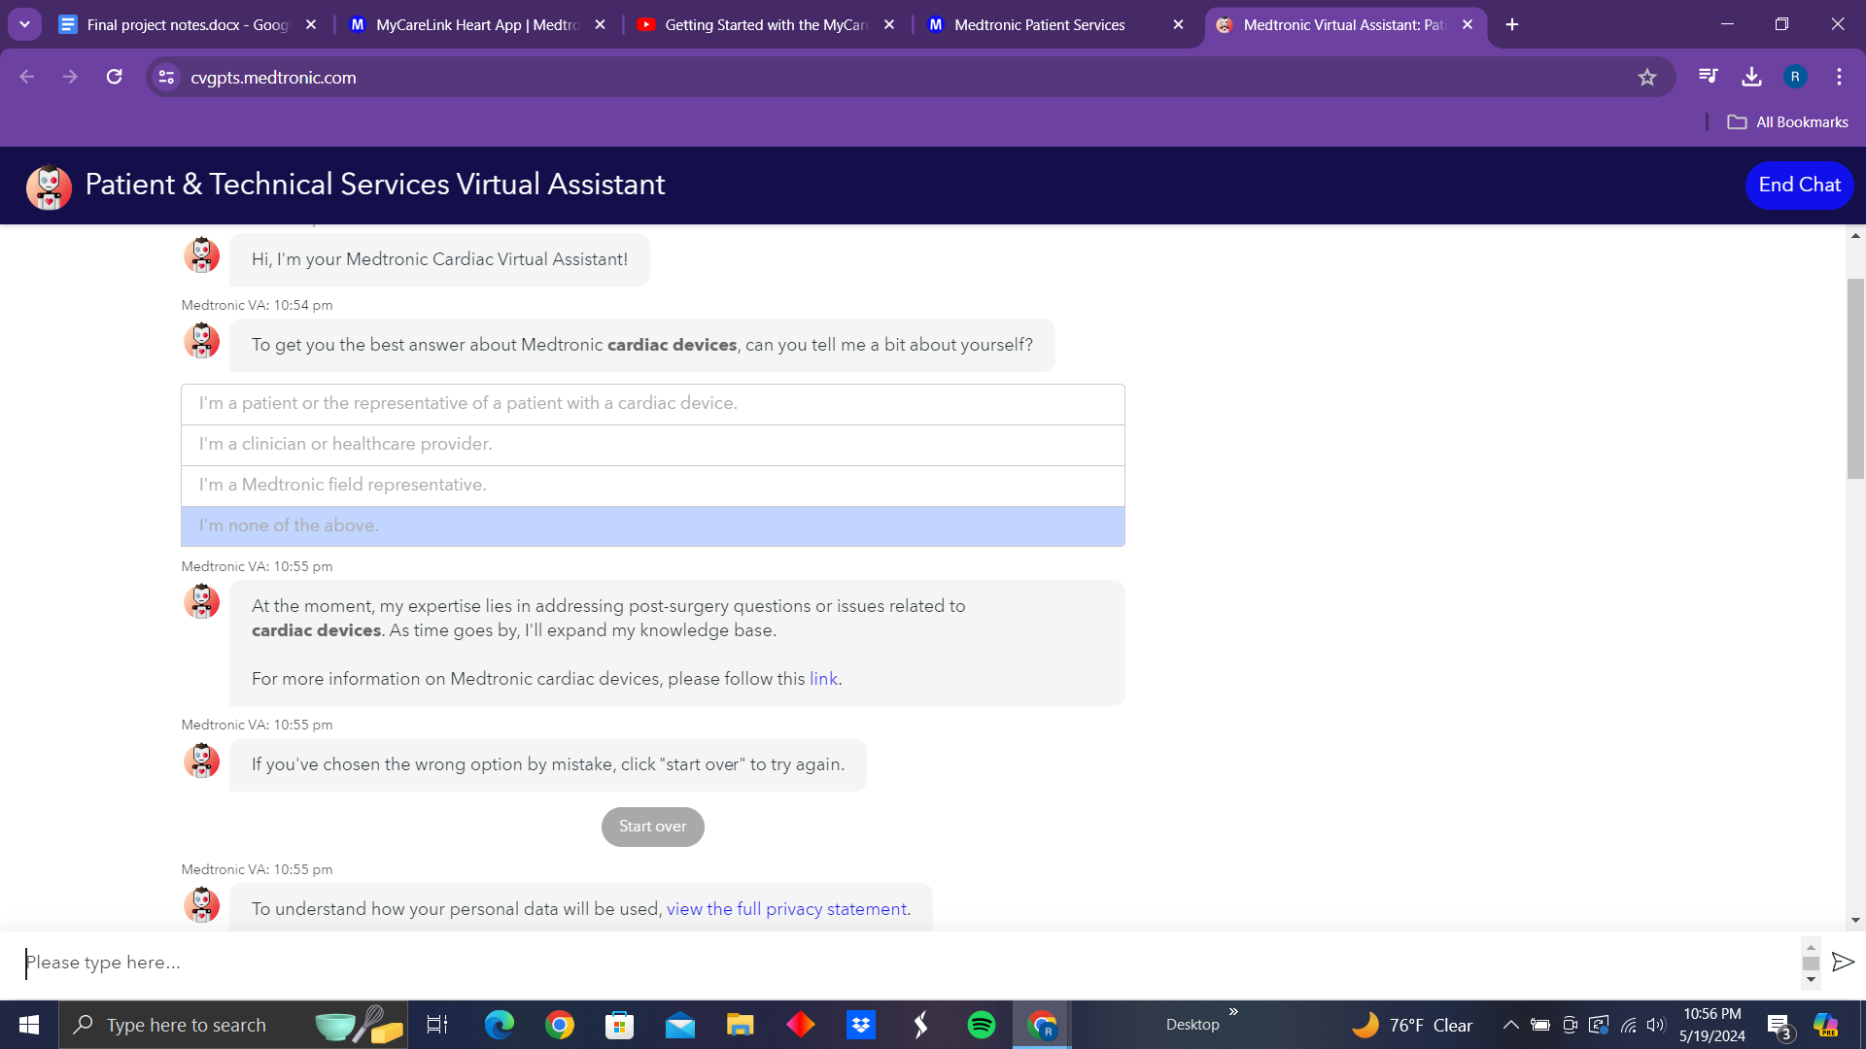

Slide 16
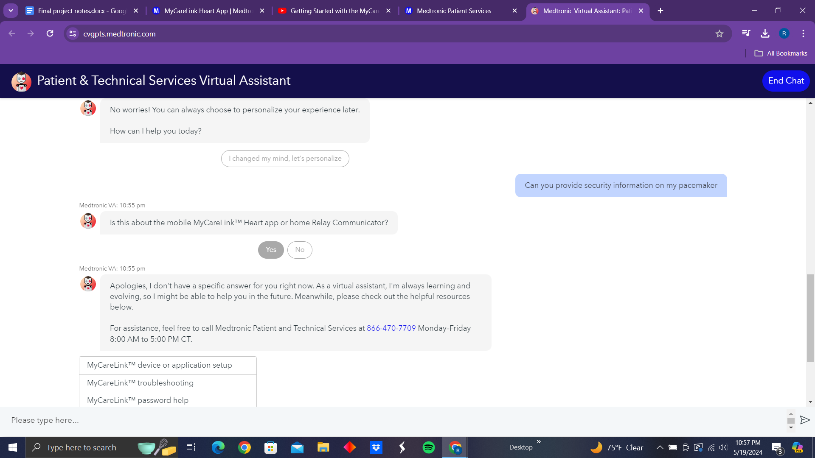

Slide 17
More on MyCareLink
The app also requires the patients device that holds the app to be up to date, with a compatibility list on their website. This pushes for patients to continually upgrade their own devices just to be able to monitor their heart themselves. A small issue to some but, for those in financial need, is it something that could hinder treatment?
The MyCareLink Heart™ app has requirements for your phone or tablet and operating system (called the “OS” from now on) version. The app cannot transfer data between your heart device and the Medtronic CareLink™ network if the requirements are not met. The requirements for your phone or tablet and OS version will change over time. You may need to update, or replace, your phone or tablet and OS to use the app to transfer data between your heart device and the Medtronic CareLink™ network.
MyCareLink Heart App. Medtronic. (n.d.)

Slide 18
A Small Closing Point
I am not here to bash on Medtronic or to state that nothing has been done in the industry. All I want to do is draw some attention to the matter at hand. As a beginner in coding, I know that there are bigger and better solutions to this than what I can come up with.
Right now, I just want to do what I can do: educate and inform.

Slide 19
Posing Some Questions?
I want to end this with just a couple questions I want you to think about. Ones that I came across that I hope make you think a little as well.
Should users have access to their pacemakers (like a personal computer) or should there be a lack of interface with them so there is less possibility of outside interference?
As medical services and systems are based in the Internet, would companies start to monetize this kind of monitoring?
What is a Medical Cyber Physical System (MCPS)?
This is for more information, a personal thing I found that I could not include.

Slide 20

Finally
Remember you matter. Protect yourself. Protect your heart.
The only one who should be in control of your life
Is you!

Slide 21


Thank you for Listening!
My School Picture -
While it is a mess, I want to thank you for staying till the end.
I hope you learned something and will explore on your own!
Thank you,
Rylan Carney
My Star I drew
Thank you all, For Everything

Slide 22
Citations
Baranchuk, A., Lakkireddy, D. R., Fisher, J. D., Upadhyay, G., Kutyifa, V., Krishnan, K., Chung, M. K., Patton, K. K., & Refaat, M. M. (n.d.). JACC journals. Journal of the American College of Cardiology. https://www.jacc.org/doi/10.1016/j.jacc.2016.06.023
Pacemaker recall highlights security concerns for implantable devices | circulation. (n.d.). https://www.ahajournals.org/doi/10.1161/CIRCULATIONAHA.118.037331
Ur Rehman, M. M., Ur Rehman, H. Z., & Kahn, Z. H. (2020, November 1). Cyber-Attacks on Medical Implants: A Case Study of Cardiac Pacemaker Vulnerability. https://journals.uob.edu.bh/bitstream/handle/123456789/4033/paper%2020.pdf?sequence=4&isAllowed=y
How medical devices like pacemakers, insulin pumps can be hacked. YouTube. (2018, November 8). https://youtu.be/smhPhmNsvVc
MyCareLink Heart App. Medtronic. (n.d.). https://global.medtronic.com/xg-en/mobileapps/patient-caregiver/cardiac-monitoring/mycarelink-heart-app.html

